Slide 1




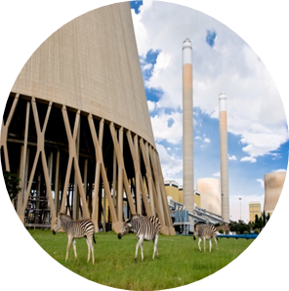

Spherical Header Tutorial
Stefan van der Walt
vdwalts@eskom.co.za
22/08/2016

Slide 2
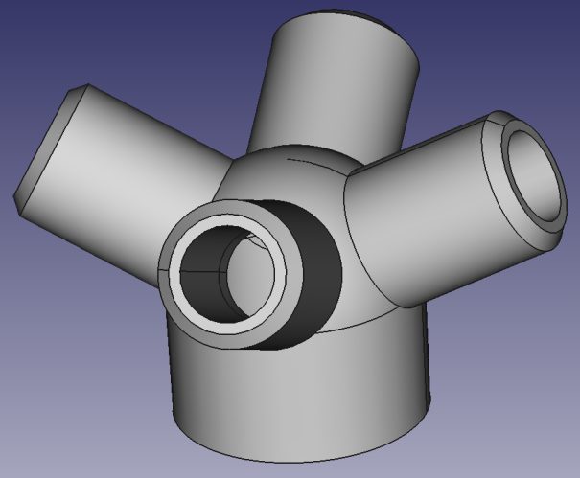
Introduction
Background:
This workshop is part 2 in the series of modelling and analysing a spherical header.
Objectives:
Adding an excavation to the header
Setting up and solving a spherical header FEM model
Analysing the results

Slide 3
Introduction
Background to problem:
A spherical header in a steam supply network is a component that divides a main steam supply into different branches or accepts steam from different branches and join it together.
Since the component is constantly under high pressure, cracks can start to occur, especially at the joints.
When these small cracks are detected, it is usually removed by excavating the affected area.
But these excavations can cause stress concentrations and the removal of material from the wall can compromise the component’s structural integrity.
During maintenance, a crack was detected on a spherical header and was removed by excavating the crack to a depth of 5[mm].

Slide 4
Introduction
Background to problem:
The question was then asked if this would compromise the integrity of the component and if not, what is the absolute maximum depth that can be excavated before the component’s integrity is compromised.
An analysis will be done to determine if an excavation of 5 [mm] compromises the component’s integrity, and then it will be determined at which depth of excavation does it start to compromise the component’s integrity.
The conditions inside the spherical header (as given by the power plant) is:
- Pressure: 17.1 MPa
- Temperature: 516 °C

Slide 5
Introduction
Background to problem:
Header details:
Material | Design Pressure | Design Temperature
11 CrM09-10 | 195 bar | 516 °C

Slide 6
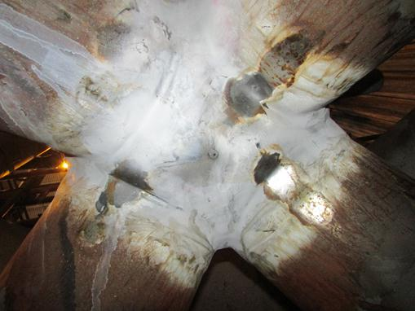
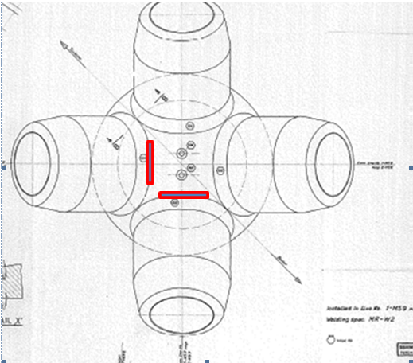
Introduction
Background to problem:
The location of the excavations on the header:

Slide 7
Introduction
Symbol | Description | Unit
A_{f} | Effective cross-sectional area | mm²
A_{p} | Pressured area | mm²
D | Diameter of shell | mm
d | Diameter of branch | mm
e_{a} | Analysis wall thickness | mm
f | Design stress | MPa (N/mm²)
l | Reinforcing length | mm
p_{c} | Calculation pressure | MPa (N/mm²)
R_{m} | Minimum Tensile Strength at room temperature | MPa (N/mm²)
R_{p0.2t} | Minimum specified value of 0.2% proof strength at calculation temperature t | MPa (N/mm²)
σ_{θ} | Hoop stress | MPa (N/mm²)
σ_{L} | Longitudinal stress | MPa (N/mm²)
Subscripts: b – branch i – inner o – outer s – shell

Slide 8
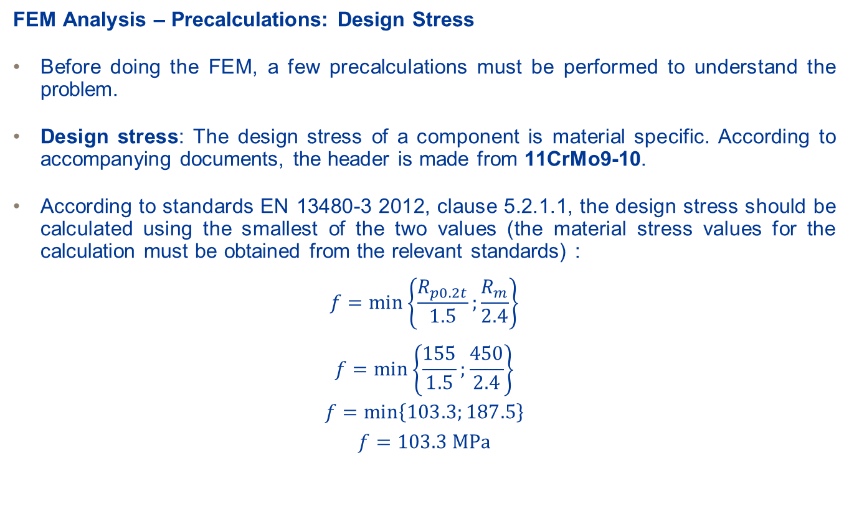
FEM Analysis – Spherical Header
FEM Analysis – Precalculations: Design Stress
Before doing the FEM, a few precalculations must be performed to understand the problem.
Design stress: The design stress of a component is material specific. According to accompanying documents, the header is made from 11CrMo9-10.
According to standards EN 13480-3 2012, clause 5.2.1.1, the design stress should be calculated using the smallest of the two values (the material stress values for the calculation must be obtained from the relevant standards) :
$$f=min⁡\left\{\frac{R_{p0.2t}}{1.5};\frac{R_{m}}{2.4}\right\}$$
$$f=min⁡\left\{\frac{155}{1.5};\frac{450}{2.4}\right\}$$
$$f=min⁡\left\{103.3;187.5\right\}$$
$$f=103.3 \text{MPa}$$

Slide 9
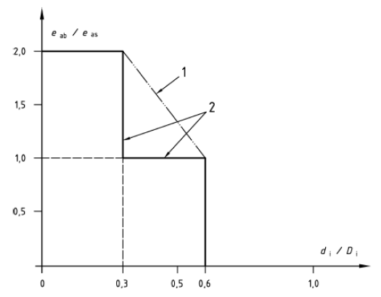
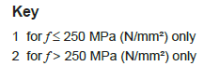
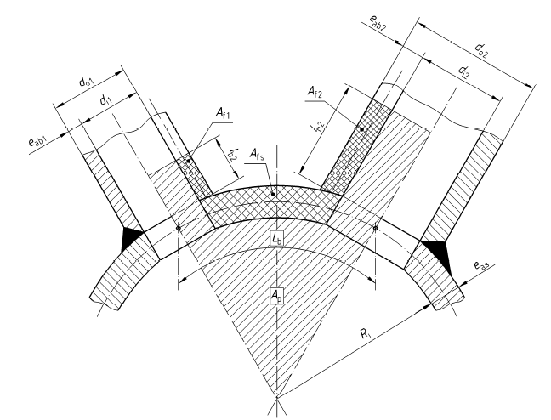
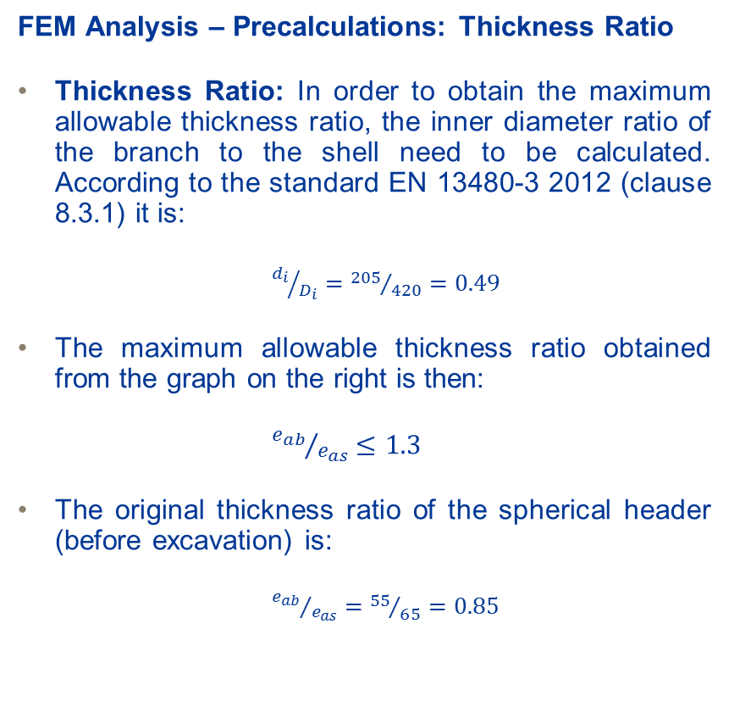
FEM Analysis – Spherical Header
FEM Analysis – Precalculations: Thickness Ratio
Thickness Ratio: In order to obtain the maximum allowable thickness ratio, the inner diameter ratio of the branch to the shell need to be calculated. According to the standard EN 13480-3 2012 (clause 8.3.1) it is:
${d_{i}}/{D_{i}}={205}/{420}=0.49$
The maximum allowable thickness ratio obtained from the graph on the right is then:
${e_{ab}}/{e_{as}}≤1.3$
The original thickness ratio of the spherical header (before excavation) is:
${e_{ab}}/{e_{as}}={55}/{65}=0.85$

Slide 10
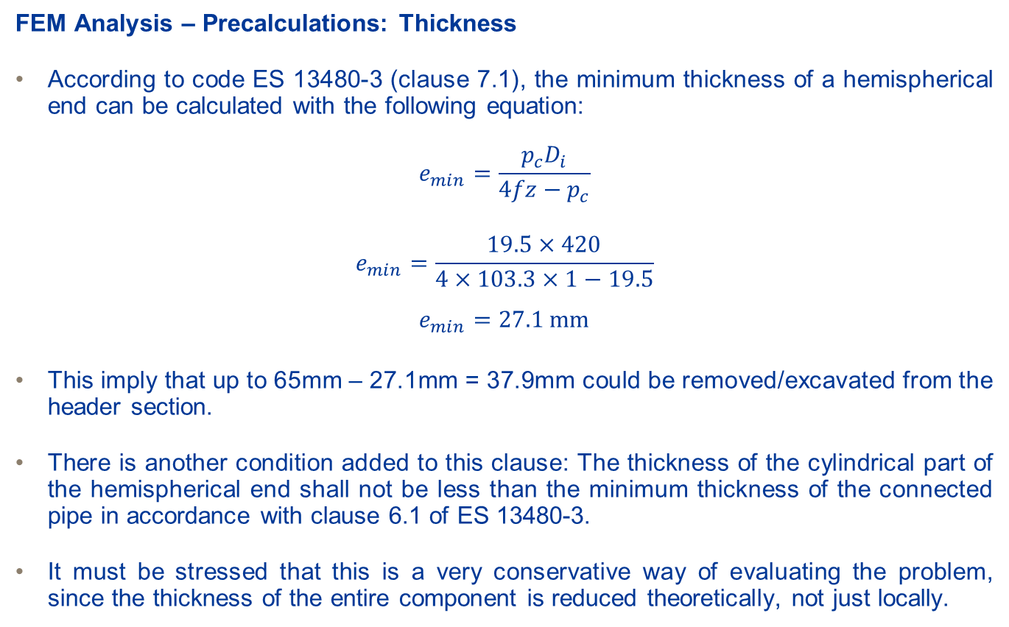
FEM Analysis – Spherical Header
FEM Analysis – Precalculations: Thickness
According to code ES 13480-3 (clause 7.1), the minimum thickness of a hemispherical end can be calculated with the following equation:
$$e_{min}=\frac{p_{c}D_{i}}{4fz−p_{c}}$$
$$e_{min}=\frac{19.5×420}{4×103.3×1−19.5}$$
$$e_{min}=27.1 \text{mm}$$
This imply that up to 65mm – 27.1mm = 37.9mm could be removed/excavated from the header section.
There is another condition added to this clause: The thickness of the cylindrical part of the hemispherical end shall not be less than the minimum thickness of the connected pipe in accordance with clause 6.1 of ES 13480-3.
It must be stressed that this is a very conservative way of evaluating the problem, since the thickness of the entire component is reduced theoretically, not just locally.

Slide 11
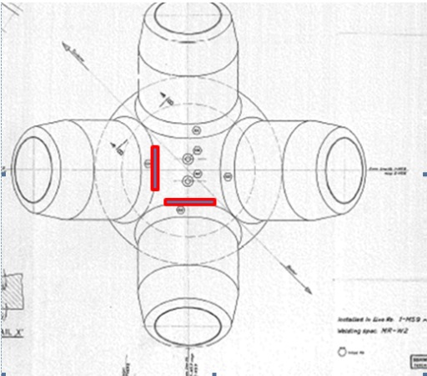
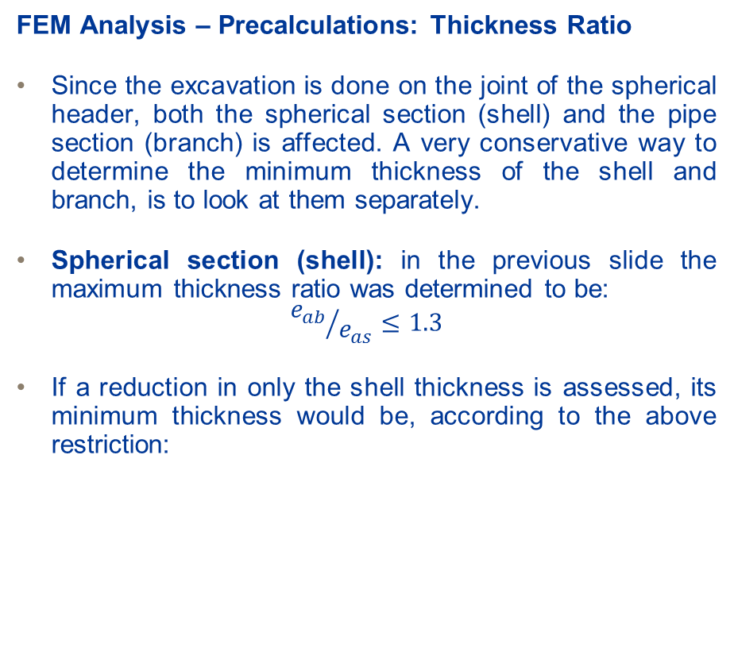
FEM Analysis – Spherical Header
FEM Analysis – Precalculations: Thickness Ratio
Since the excavation is done on the joint of the spherical header, both the spherical section (shell) and the pipe section (branch) is affected. A very conservative way to determine the minimum thickness of the shell and branch, is to look at them separately.
Spherical section (shell): in the previous slide the maximum thickness ratio was determined to be:
$${e_{ab}}/{e_{as}}≤1.3$$
If a reduction in only the shell thickness is assessed, its minimum thickness would be, according to the above restriction:
Reduction in thickness in mm of e_{as} | e_{ab} / e_{as}
5 | 0.92
10 | 1
15 | 1.1
20 | 1.22
23 | 1.31
25 | 1.38

Slide 12
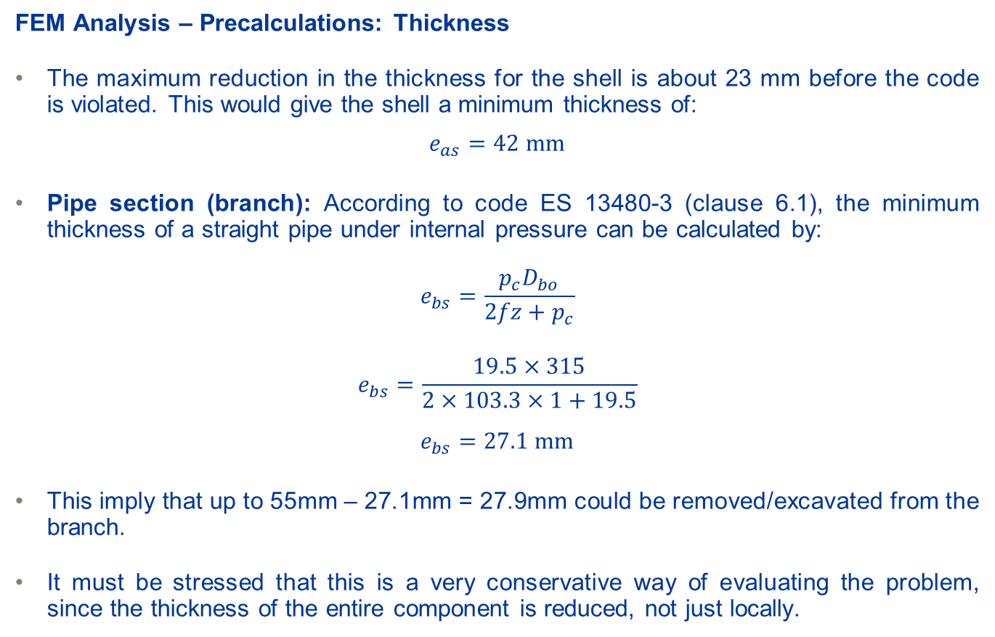
FEM Analysis – Spherical Header
FEM Analysis – Precalculations: Thickness
The maximum reduction in the thickness for the shell is about 23 mm before the code is violated. This would give the shell a minimum thickness of:
$$e_{as}=42 mm$$
Pipe section (branch): According to code ES 13480-3 (clause 6.1), the minimum thickness of a straight pipe under internal pressure can be calculated by:
$$e_{bs}=\frac{p_{c}D_{bo}}{2fz+p_{c}}$$
$$e_{bs}=\frac{19.5×315}{2×103.3×1+19.5}$$
$$e_{bs}=27.1 \text{mm}$$
This imply that up to 55mm – 27.1mm = 27.9mm could be removed/excavated from the branch.
It must be stressed that this is a very conservative way of evaluating the problem, since the thickness of the entire component is reduced, not just locally.

Slide 13
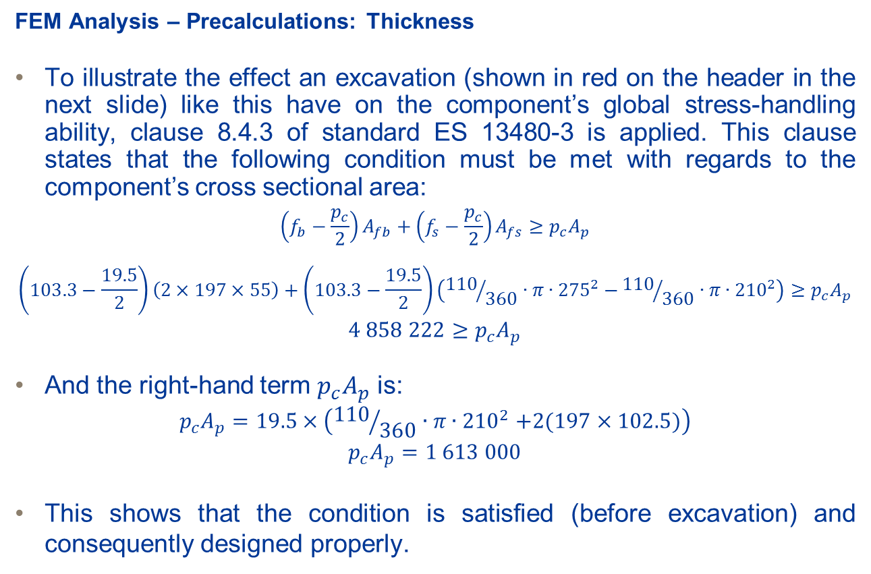
FEM Analysis – Spherical Header
FEM Analysis – Precalculations: Thickness
To illustrate the effect an excavation (shown in red on the header in the next slide) like this have on the component’s global stress-handling ability, clause 8.4.3 of standard ES 13480-3 is applied. This clause states that the following condition must be met with regards to the component’s cross sectional area:
$$\left(f_{b}−\frac{p_{c}}{2}\right)A_{fb}+\left(f_{s}−\frac{p_{c}}{2}\right)A_{fs}≥p_{c}A_{p}$$
$$\left(103.3−\frac{19.5}{2}\right)\left(2×197×55\right)+\left(103.3−\frac{19.5}{2}\right)\left({110}/{360}∙π{∙275}^{2}−{110}/{360}∙π{∙210}^{2}\right)≥p_{c}A_{p}$$
$$4 858 222≥p_{c}A_{p}$$
And the right-hand term $p_{c}A_{p}$ is:
$$p_{c}A_{p}=19.5×\left({110}/{360}∙π{∙210}^{2}+2(197×102.5)\right)$$
$$p_{c}A_{p}=1 613 000$$
This shows that the condition is satisfied (before excavation) and consequently designed properly.

Slide 14
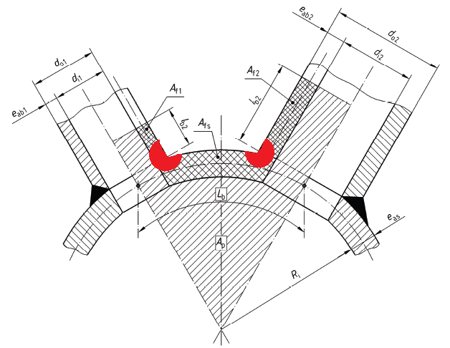
FEM Analysis – Spherical Header
FEM Analysis – Precalculations: Thickness
To show how little effect an excavation (shown in red) like this actually have on the component’s global stress-handling ability, the left-side and right side terms of the condition given on the previous slide are shown in the table below. According to the code the left-side term must always be larger than the right-side term, and in the table below it can be seen that even a large excavation doesn’t compromise the condition. But excavations also cause localised stresses which the code can’t always take into account, and this will be shown in the FEM analysis.
Excavation Depth [mm] | Left-Side Term | Right-Side Term
5 | 4 854 549 | 1 613 000
10 | 4 843 528 | 1 613 000
20 | 4 799 443 | 1 613 000
30 | 4 725 969 | 1 613 000
50 | 4 490 852 | 1 613 000

Slide 15
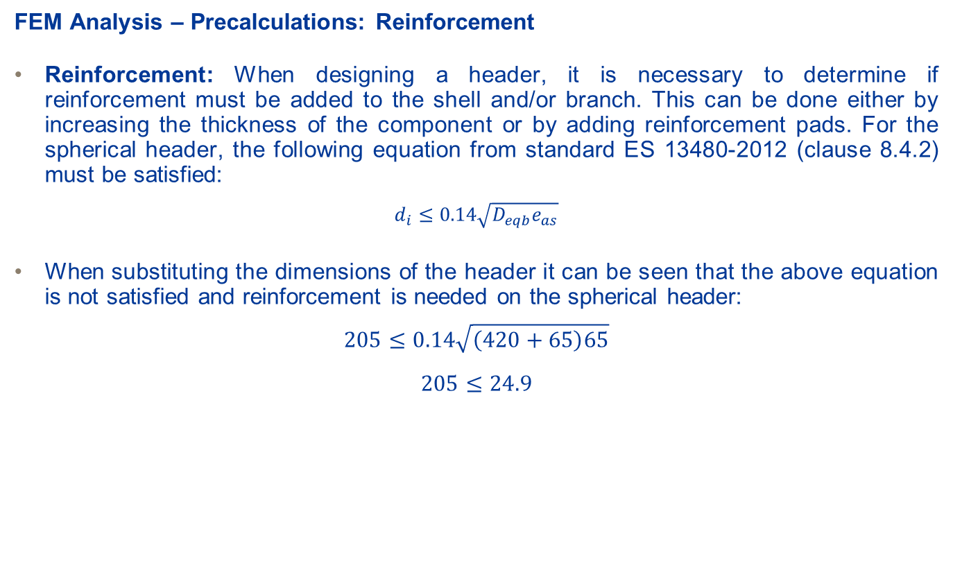
FEM Analysis – Spherical Header
FEM Analysis – Precalculations: Reinforcement
Reinforcement: When designing a header, it is necessary to determine if reinforcement must be added to the shell and/or branch. This can be done either by increasing the thickness of the component or by adding reinforcement pads. For the spherical header, the following equation from standard ES 13480-2012 (clause 8.4.2) must be satisfied:
$$d_{i}≤0.14\sqrt{D_{eqb}e_{as}}$$
When substituting the dimensions of the header it can be seen that the above equation is not satisfied and reinforcement is needed on the spherical header:
$$205≤0.14\sqrt{\left(420+65\right)65}$$
$$205≤24.9$$

Slide 16
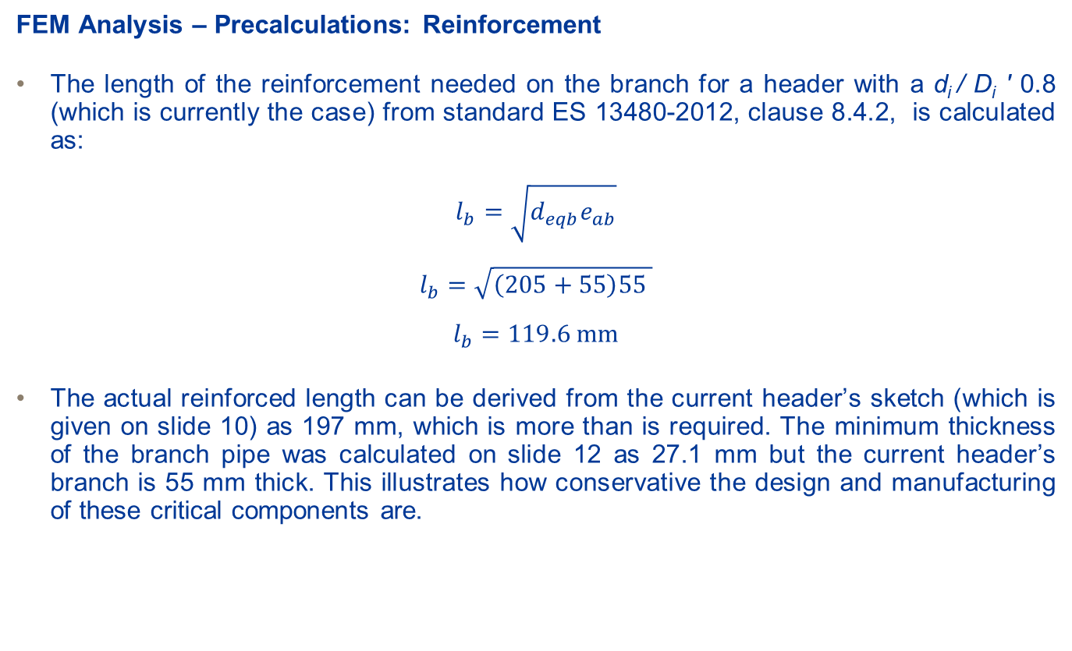
FEM Analysis – Spherical Header
FEM Analysis – Precalculations: Reinforcement
The length of the reinforcement needed on the branch for a header with a d_{i} / D_{i} ' 0.8 (which is currently the case) from standard ES 13480-2012, clause 8.4.2, is calculated as:
$$l_{b}=\sqrt{d_{eqb}e_{ab}}$$
$$l_{b}=\sqrt{\left(205+55\right)55 }$$
$$l_{b}=119.6 \text{mm}$$
The actual reinforced length can be derived from the current header’s sketch (which is given on slide 10) as 197 mm, which is more than is required. The minimum thickness of the branch pipe was calculated on slide 12 as 27.1 mm but the current header’s branch is 55 mm thick. This illustrates how conservative the design and manufacturing of these critical components are.

Slide 17
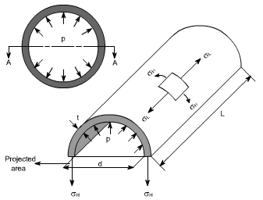
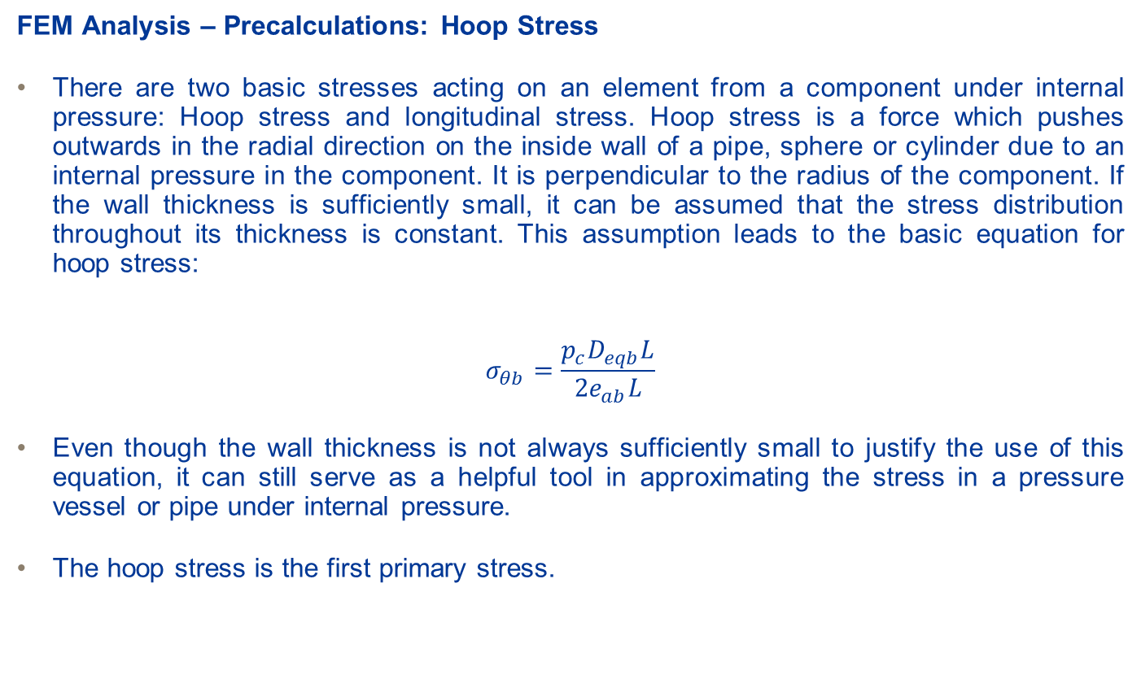
FEM Analysis – Spherical Header
FEM Analysis – Precalculations: Hoop Stress
There are two basic stresses acting on an element from a component under internal pressure: Hoop stress and longitudinal stress. Hoop stress is a force which pushes outwards in the radial direction on the inside wall of a pipe, sphere or cylinder due to an internal pressure in the component. It is perpendicular to the radius of the component. If the wall thickness is sufficiently small, it can be assumed that the stress distribution throughout its thickness is constant. This assumption leads to the basic equation for hoop stress:
$$σ_{θb}=\frac{p_{c}D_{eqb}L}{2e_{ab}L}$$
Even though the wall thickness is not always sufficiently small to justify the use of this equation, it can still serve as a helpful tool in approximating the stress in a pressure vessel or pipe under internal pressure.
The hoop stress is the first primary stress.

Slide 18
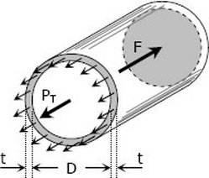
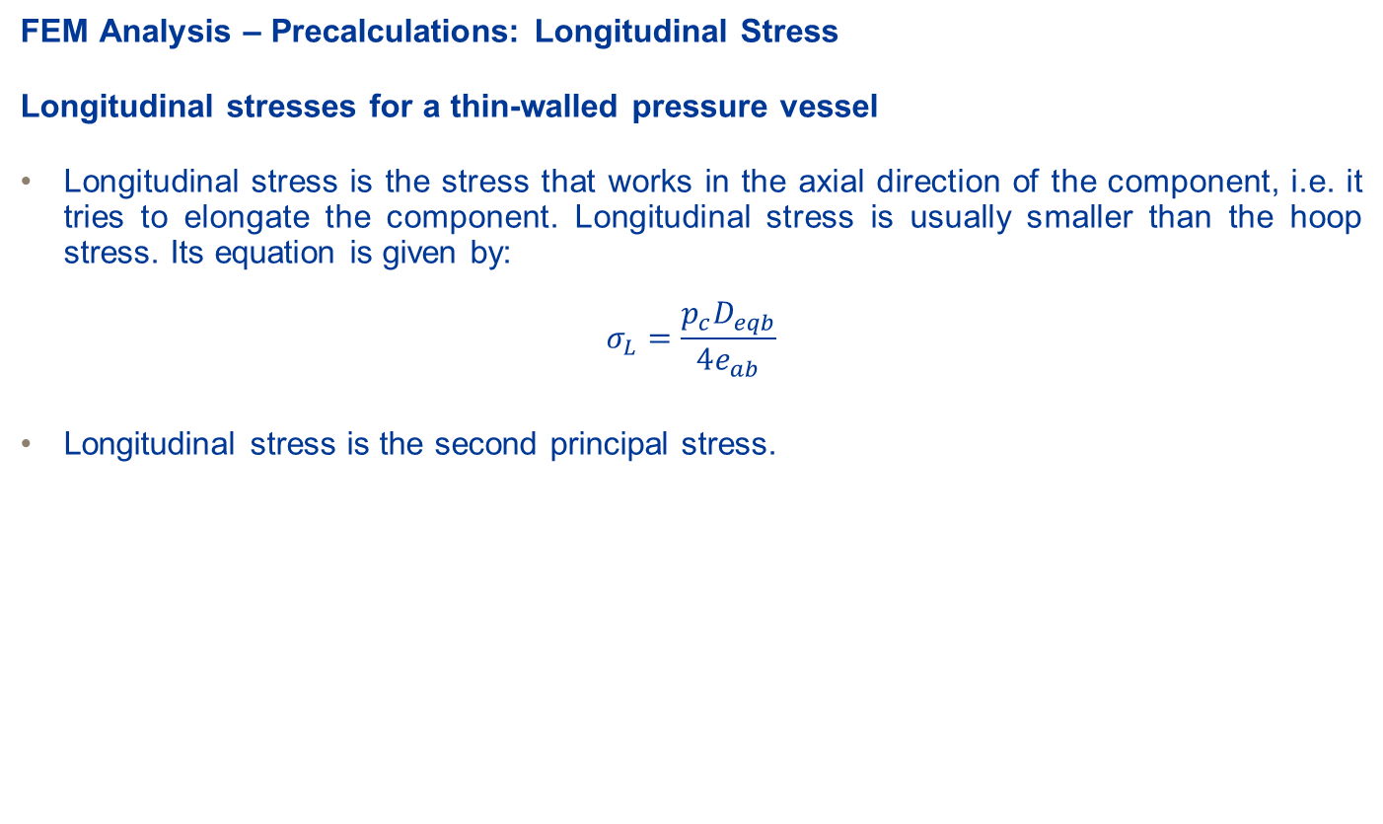
FEM Analysis – Spherical Header
FEM Analysis – Precalculations: Longitudinal Stress
Longitudinal stresses for a thin-walled pressure vessel
Longitudinal stress is the stress that works in the axial direction of the component, i.e. it tries to elongate the component. Longitudinal stress is usually smaller than the hoop stress. Its equation is given by:
$$σ_{L}=\frac{p_{c}D_{eqb}}{4e_{ab}}$$
Longitudinal stress is the second principal stress.

Slide 19
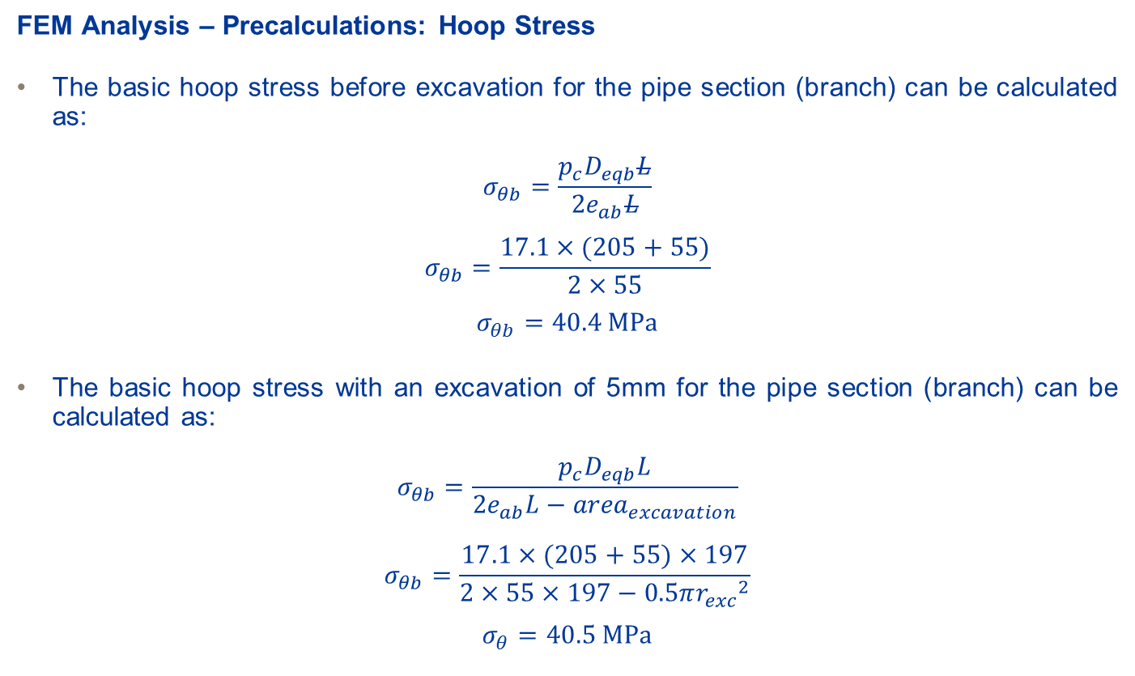
FEM Analysis – Spherical Header
FEM Analysis – Precalculations: Hoop Stress
The basic hoop stress before excavation for the pipe section (branch) can be calculated as:
$$σ_{θb}=\frac{p_{c}D_{eqb}L}{2e_{ab}L}$$
$$σ_{θb}=\frac{17.1×(205+55)}{2×55}$$
$$σ_{θb}=40.4 \text{MPa}$$
The basic hoop stress with an excavation of 5mm for the pipe section (branch) can be calculated as:
$$σ_{θb}=\frac{p_{c}D_{eqb}L}{2e_{ab}L−{area}_{excavation}}$$
$$σ_{θb}=\frac{17.1×(205+55)×197}{2×55×197−0.5π{r_{exc}}_{}^{2}}$$
$$σ_{θ}=40.5 \text{MPa}$$

Slide 20
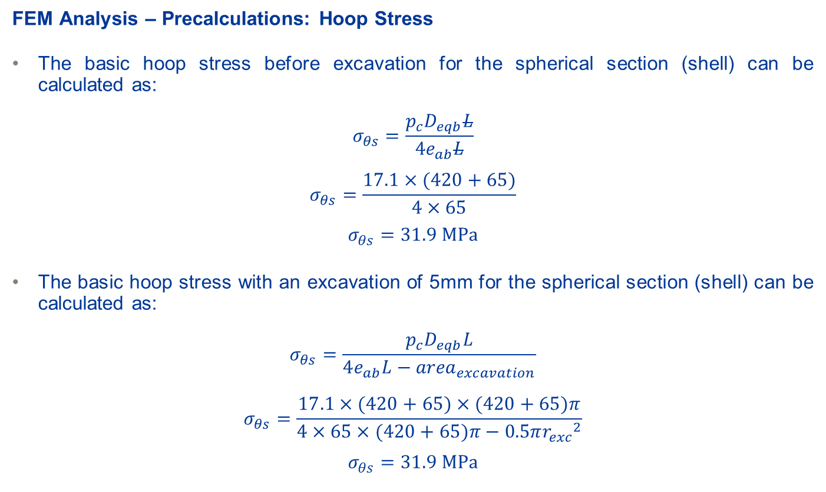
FEM Analysis – Spherical Header
FEM Analysis – Precalculations: Hoop Stress
The basic hoop stress before excavation for the spherical section (shell) can be calculated as:
$$σ_{θs}=\frac{p_{c}D_{eqb}L}{4e_{ab}L}$$
$$σ_{θs}=\frac{17.1×(420+65)}{4×65}$$
$$σ_{θs}=31.9 \text{MPa}$$
The basic hoop stress with an excavation of 5mm for the spherical section (shell) can be calculated as:
$$σ_{θs}=\frac{p_{c}D_{eqb}L}{4e_{ab}L−{area}_{excavation}}$$
$$σ_{θs}=\frac{17.1×(420+65)×(420+65)π}{4×65×(420+65)π−0.5π{r_{exc}}_{}^{2}}$$
$$σ_{θs}=31.9 \text{MPa}$$

Slide 21
FEM Analysis – Spherical Header
FEM Analysis – Precalculations: Hoop Stress Comparison
The table below illustrate the effect of the excavations on the hoop stresses of the branch and shell respectively.
It can be seen from the calculations for the hoop stresses that the excavation has little effect on the component’s global hoop stress. The reason for this is because the reduction in cross-sectional area due to the excavation is almost negligible. But this doesn’t mean that local stress concentrations will not occur, especially around the excavated area. That is why a FEM analysis is essential.
Excavation Depth [mm] | Spherical section hoop stress | Pipe section hoop stress
5 | 31.901 | 40.491
10 | 31.910 | 40.713
20 | 31.948 | 41.625
50 | 32.217 | 49.363

Slide 22
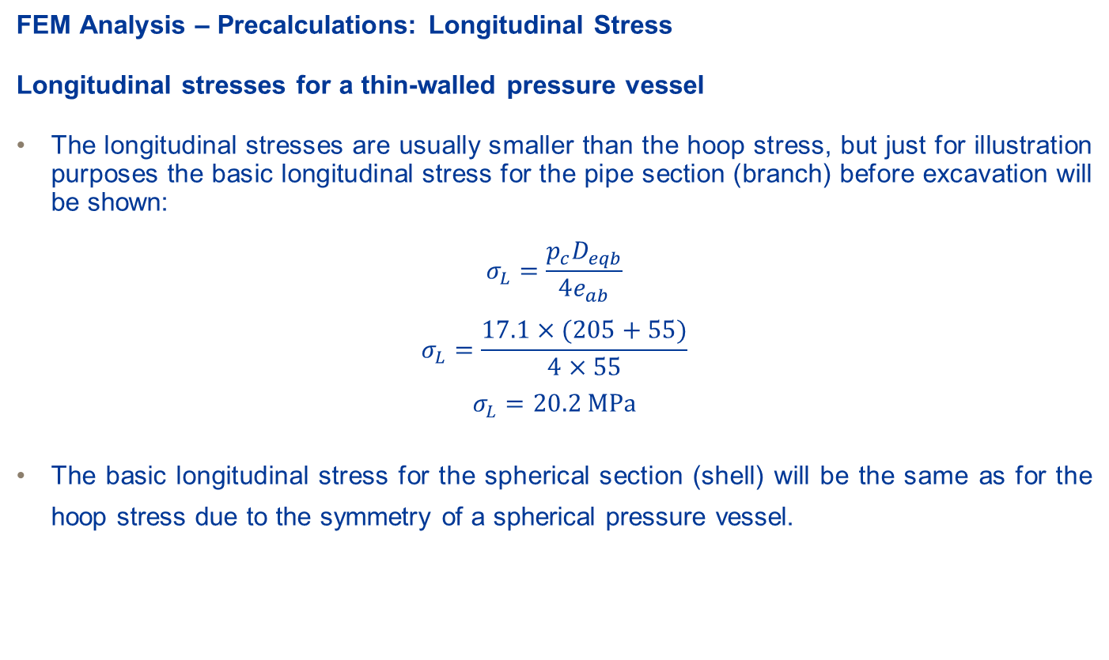
FEM Analysis – Spherical Header
FEM Analysis – Precalculations: Longitudinal Stress
Longitudinal stresses for a thin-walled pressure vessel
The longitudinal stresses are usually smaller than the hoop stress, but just for illustration purposes the basic longitudinal stress for the pipe section (branch) before excavation will be shown:
$$σ_{L}=\frac{p_{c}D_{eqb}}{4e_{ab}}$$
$$σ_{L}=\frac{17.1×(205+55)}{4×55}$$
$$σ_{L}=20.2 \text{MPa}$$
The basic longitudinal stress for the spherical section (shell) will be the same as for the hoop stress due to the symmetry of a spherical pressure vessel.

Slide 23
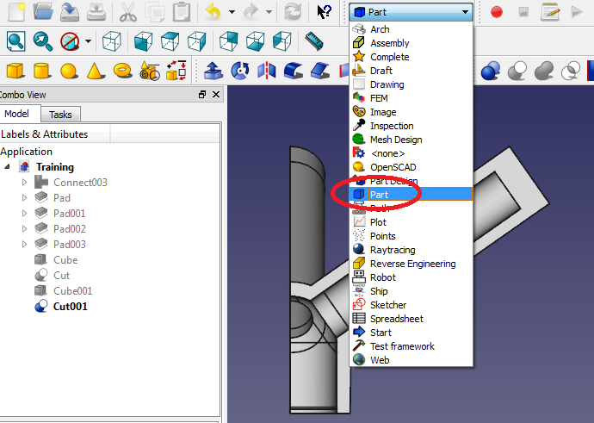
FEM Analysis – Spherical Header
Adding the excavation to the CAD model – Adding the cutting torus
A torus will be used to simulate the excavation of the material on the header. In order to avoid unnecessary stress concentrations due to sharp corners caused by cutting away material with the torus, we are going to use relatively large diameters for the torus. The excavation will be made where the branch and the header connect (joint).
Change to the 'Part Workbench‘.

Slide 24
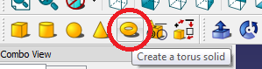
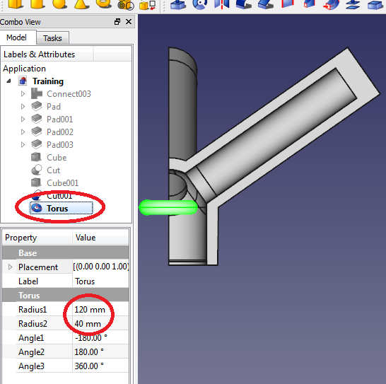
FEM Analysis – Spherical Header
Adding the excavation to the CAD model – Adding the cutting torus
Click on the 'Create a torus solid' icon .
You should notice a new Torus label added to the tree view. Click on the Torus part in the Tree view. Its properties should be visible in the properties window underneath the tree view.
Change the torus’ radius 1 to 120mm (it is the radius of the entire torus), and the radius 2 to 40mm (it is the radius of the circle enveloping the torus body, responsible for the tube-like appearance).

Slide 25
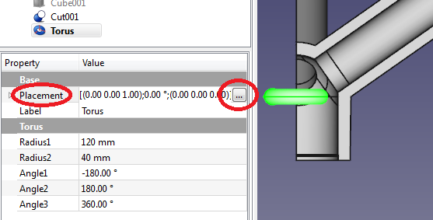
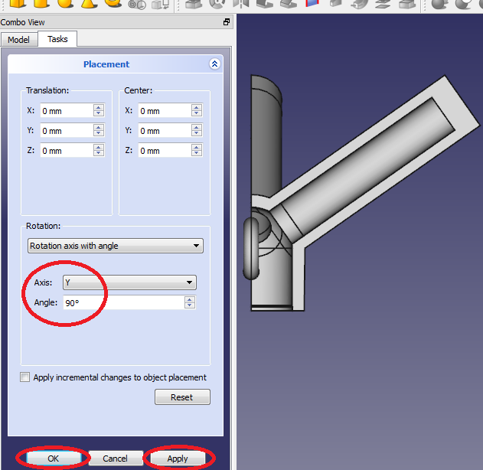
FEM Analysis – Spherical Header
Adding the excavation to the CAD model – Adding the cutting torus
The torus is laying on its side, and must be brought into an upright position. Click on the ‘Placement’ heading in the properties window. An icon with three dots on it should appear . Click on the icon.
A dialogue box should open in the task tab. Under the ‘Rotation’ heading, change the axis of rotation to the y-axis and the angle to 90°.
Click on apply and the click on ‘OK’ to close the dialogue.

Slide 26
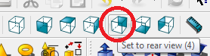
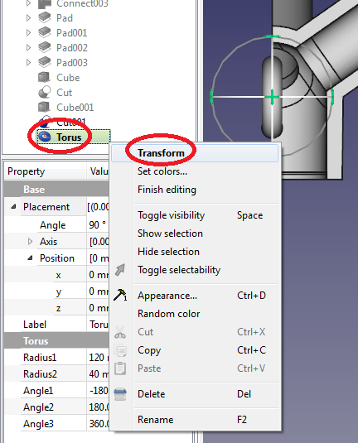
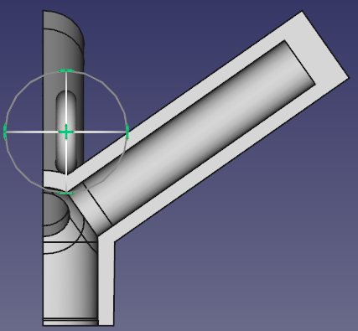
FEM Analysis – Spherical Header
Adding the excavation to the CAD model – Adding the cutting torus
Change the view of the part to the ‘Rear View’ either by clicking on the rear view icon or by pressing the number 4 key on the numeric keypad on your keyboard (if available).
Now the torus’ location should be changed in order for it to remove material from the header. Right click on the ‘Torus’ label in the tree view, and select ‘Transform’. A wheel with arrows should appear around the torus in the display window.
Click and drag on the center arrow to reposition the torus on the xz-plane. It should touch the header at the joint.

Slide 27
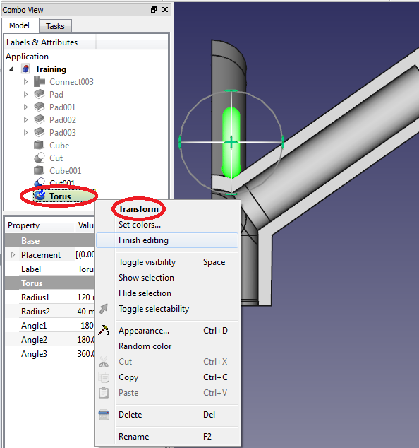
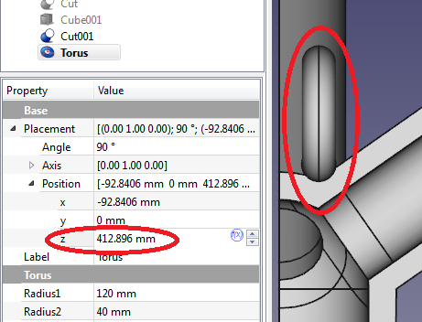
FEM Analysis – Spherical Header
Adding the excavation – cutting away the material
Right click on the torus label in the tree view again, and select ‘finish editing’ to finish the reposition.
For the first analysis, we will only excavate 5mm from the header, as was done during maintenance. Click on the arrow to the left of the ‘Placement’ heading. It should expand into subheadings.
Click on the arrow to the left of the ‘Position’ heading to open the x-, y- and z-coordinates for the torus. In order for the torus to cut away 5mm, it must be lowered by 5mm into the header. Subtract 5mm from the z-axis coordinate to achieve this.
NOTE: the x- and z-coordinates may differ slightly, since the torus was dragged in an imprecise manner with the mouse to its current position. But it should be within a few millimeters of the values shown here.

Slide 28
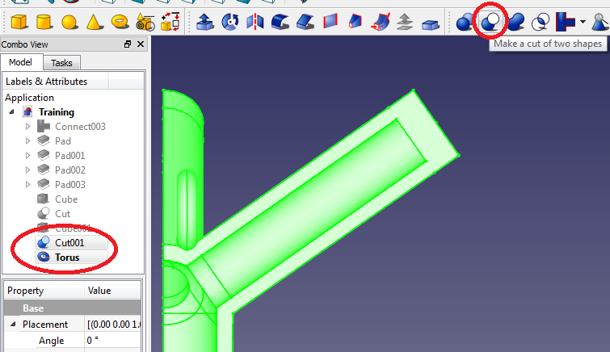
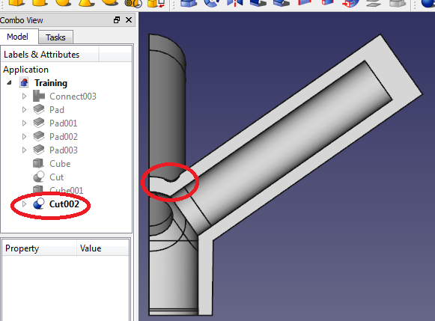
FEM Analysis – Spherical Header
Adding the excavation – cutting away the material
The excavation must now be made using the ‘Cut’ feature. Select the header either by double-clicking on it in the display window or by clicking on the last feature involving the header. It should be the ‘Cut001’ feature. You can recognise the last feature created by being the only feature not greyed out (except for the torus). If the header doesn’t display green in the display window, the wrong feature have been selected.
While holding ‘Ctrl’ on your keyboard, also select the Torus in the tree view. Both parts should now display green in the display window. It is important to select the header FIRST and only after that the torus.
Click on the ‘Make a cut of two shapes’ feature in the taskbar . The excavation have now been made and a new label have been added to the tree view.

Slide 29
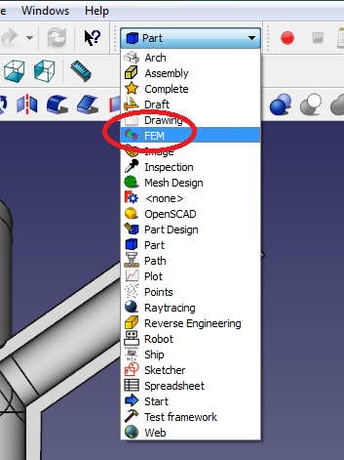
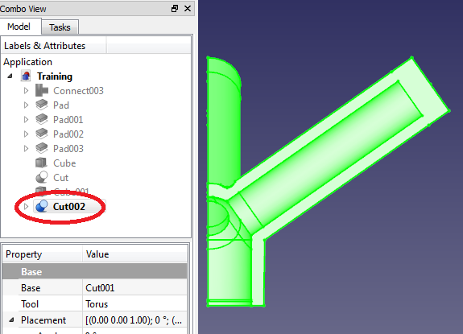
FEM Analysis – Spherical Header
FEM Analysis – Creating the Mesh
Change to the FEM workbench.
Select the header either by double-clicking on it in the display window or by selecting the label in the tree view that’s not greyed out – it should be the label from the last feature that was applied to the header, and when selecting it, the header should be highlighted green in the display window.

Slide 30
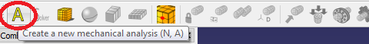
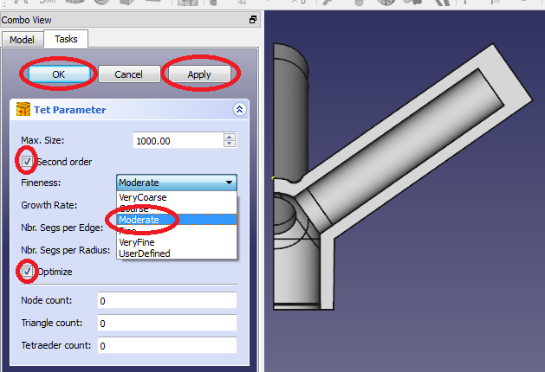
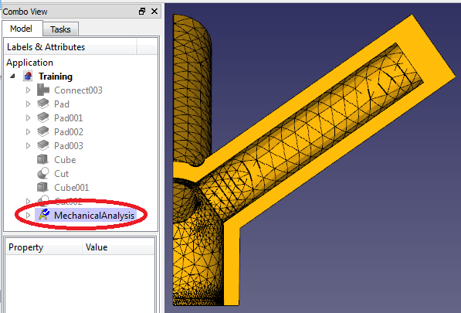
FEM Analysis – Spherical Header
FEM Analysis – Creating the Mesh
Click on 'Create a new mechanical analysis'.
Since the header part was already selected before the new mechanical analysis was created, the meshing dialogue box will automatically open. If not, the mesh should be added manually, which will be shown here.
Ensure that the tick box next to the ‘Second order’ option is selected. (this ensures a more accurate mesh on curved surfaces).
There is a dropdown box next to ‘Fineness’, with options ranging from ‘Very Coarse’ to ‘Very Fine’. A coarser mesh will set-up and solve faster, while a finer mesh will be more accurate. Start with a coarser mesh and select ‘Moderate’. Ensure that the tick box next to ‘Optimize’ is selected to automatically improve the mesh.
Click ‘Apply’ to apply the mesh, and then ‘OK’.

Slide 31
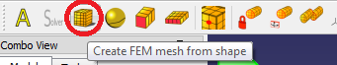
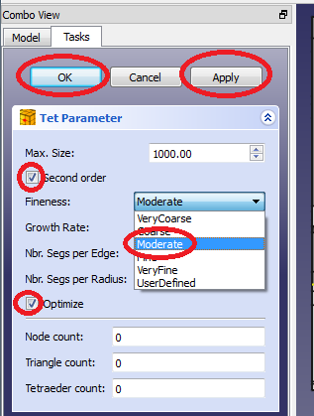
FEM Analysis – Spherical Header
FEM Analysis – Manually adding the Mesh
The next two slides is to show how to add a mesh if the mesh dialogue didn’t appear automatically after creating a new mechanical analysis..
Select the header either by double-clicking on it in the display window or by selecting the label in the tree view that’s not greyed out – it should be the label from the last feature that was applied to the header, and when selecting it, the header should be highlighted green in the display window.
Click on the ‘Create FEM mesh from shape’ icon on the taskbar. A task dialogue will appear for creating a mesh. Ensure the tick box next to ‘Second order’ is selected, select a ‘Moderate’ mesh and ensure the tick box next to ‘Optimize’ is selected.
Click ‘Apply’ to apply the mesh and ‘OK’ to close the mesh dialogue.

Slide 32
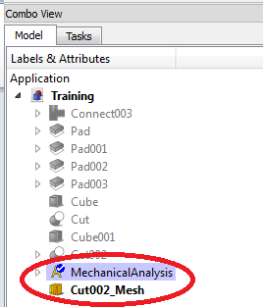
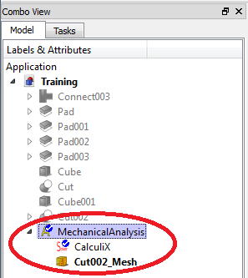
FEM Analysis – Spherical Header
FEM Analysis – Manually adding the Mesh
When the mesh is added manually, it is not automatically added to the mechanical analysis. Instead it remains separately in the tree view.
In order to add the mesh to the mechanical analysis, simply drag and drop the mesh label in the tree view onto the mechanical analysis label and it should be added to it.
Expand the mechanical analysis in the tree view by clicking on the arrow to the left of it, the mesh should now be there.

Slide 33
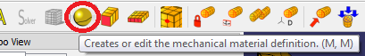
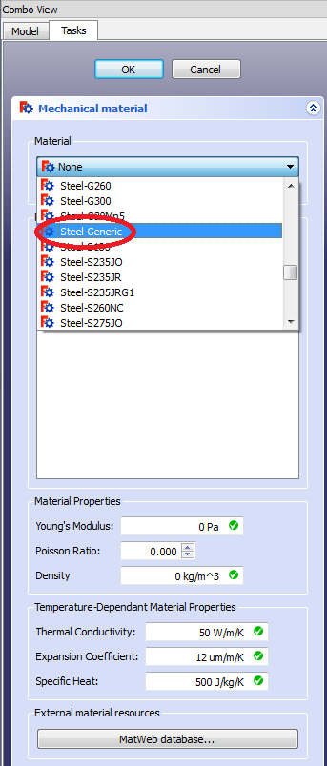
FEM Analysis – Spherical Header
FEM Analysis – Material Specification
A material need to be specified for each part. Select the ‘Add mechanical material’ icon from the taskbar.
A dialogue for selecting a mechanical material will appear. Under material, select 'Steel-Generic'.
The material properties can also be edited by the user.
Click ‘OK’ to close the dialogue.

Slide 34
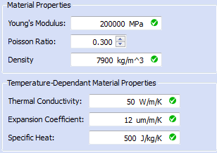
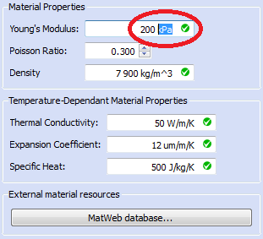
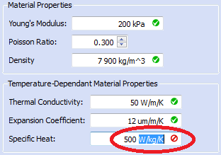
FEM Analysis – Spherical Header
FEM Analysis – A Note on Material Properties and Units
If you look at the bottom half of the material properties card, you will see the properties with values and units. You can change both the values and the units (within reason).
Every property has a base unit / derived unit connected to it, so if the units are changed, the resulting units must still be the same. For example, for the Young’s Modulus the unit can be changed to kiloPascal by typing ‘kPa’ over the current unit of MPa.
Also notice the green checkmark next to each unit. This indicates whether the unit is dimensionally correct or not. For instance, if you change the unit for specific heat from ‘J/kg/K’ to ‘W/kg/K’, it will show an error sign.

Slide 35
FEM Analysis – Spherical Header
FEM Analysis – A Note on Material Properties and Units
If there is a red error sign next to a property’s units, it must be changed to an acceptable unit before the changes can be applied otherwise it will discard the changes.
Be careful when changing units, and ensure the value accompanying the units is also consistent with the units.
Also note that certain diminutives or augmentations of units are currently not supported, for instance the unit ‘Watt’ (or ‘W’) is supported, but ‘kiloWatt’ (‘kW’) and ‘milliWatt’ (‘mW’) etc. is not supported yet.

Slide 36
FEM Analysis – Spherical Header
FEM Analysis – Boundary Conditions
The user has access to different types of boundary conditions which include displacement, load and temperature. If your goal is only to run a static analysis, then you don’t need to add temperature or heat flux constraints (which is needed for a thermo-mechanical analysis).
The table on the right illustrate which constraints are needed for a static and a thermo-mechanical analysis respectively.
Constraints | Static Analysis | Thermo-mech Analysis
Plane Rotation Face | ✓ | ✓
Displacement | ✓ | ✓
Internal Pressure | ✓ | ✓
Initial temperature |  | ✓
heat flux on a face |  | ✓
Temperature on a face |  | ✓

Slide 37

FEM Analysis – Spherical Header
FEM Analysis – Boundary Conditions
There are different ways of accounting for the loads and stresses inside a continuous tube (which is also connected to other components), and since only a short section of pipe is being modeled, the simulation can show unrealistic bending of the short pipe sections. One way to prevent this bending is to add end caps on the pipe, and adding a constraint which forces the end caps to stay in-plane. This will account for the correct axial load and prevent the short section of simulated pipe from bending. This can be done using 'Create FEM constraint for Plane Rotation face'. Please note that each end cap will need to be constrained separately with the plane rotation constraint (i.e. there will be two plane rotation constraints added, one for each end cap).

Slide 38



FEM Analysis – Spherical Header
FEM Analysis – Boundary Conditions
Open the ‘Plane Rotation Face’ constraint by clicking on its icon in the taskbar menu. A dialogue box appear.
Select the outer surface of one end cap by clicking on that surface in the display window, and click ‘Add’. The face should be added in the constraint parameter box, and green discs should appear on that face.
Press ‘OK’ to close the dialogue.
Repeat this process to add a separate plane rotation constraint to the other end cap.

Slide 39



FEM Analysis – Spherical Header
FEM Analysis – Boundary Conditions
Since only a quarter of the header will be modeled, it is important to account for this using symmetry.
To model symmetry, use the 'Create FEM constraint for a displacement acting on a face' boundary condition. Each cut face in the direction perpendicular to the face will be fixed to prevent it from moving in that direction. You will need to look at the axes on the bottom right hand corner in the display window to ensure you model it correctly.
Click on the ‘Displacement Constraint’ icon on the taskbar. A task dialogue will appears.
Click on the face indicated in the picture and fix the face in the y-axis. Check the axis in the display window to ensure that the y-axis is perpendicular to that face.

Slide 40


FEM Analysis – Spherical Header
FEM Analysis – Boundary Conditions
Similarly add the constraints to the other faces, fixing its motion on the axis perpendicular to the face as indicated in the pictures.
Remember to ensure that the face is constrained in the correct direction by checking the axis in the bottom right hand corner of the display window.

Slide 41


FEM Analysis – Spherical Header
FEM Analysis – Boundary Conditions
Add an internal pressure to all the internal faces of the spherical header (including the inside surface of the end caps). To do so, click on the ‘Pressure Constraint‘ icon on the taskbar.
The reason a pressure is also added to the endcaps, is due to the fact that there will be a component or a change in pipe direction causing a pressure to be applied in the axial direction.
A Task dialogue will appear. While holding down the ‘Ctrl’ key on your keyboard, click on all the inner surfaces where steam flow will occur in the header in the display window. All the selected surfaces should be green.

Slide 42


FEM Analysis – Spherical Header
FEM Analysis – Boundary Conditions
After selecting the appropriate surfaces, click ‘Add’.
Input a pressure of 17.1 MPa (or the appropriate pressure according to the particular system in question) as indicated in the picture.
The units of the pressure can also be changed to e.g. Pascal (‘Pa’) or kiloPascal (‘kPa’). As long as the green checkmark appear next to the unit, it will be fine. Just ensure that the accompanying value of the pressure corresponds with its unit.
The final geometry with all the boundary conditions needed for a static analysis should be as indicated in the picture.

Slide 43
FEM Analysis – Spherical Header
FEM Analysis – Boundary Conditions for Thermo-Mechanical Analysis
If you only want to run a static analysis (with just the effect of pressure), then the constraints added up to this point is sufficient to run the analysis and you can skip to the slide with the heading 'FEM analysis - running the analysis'.
If you want to run a thermo-mechanical analysis (where the stresses caused by temperature are also added), then the constraints explained in the next few slides will also be needed.
This analysis will focus on a thermo-mechanical analysis of the spherical header.
The table on the right (also shown earlier) shows which constraints are needed for the static and the thermo-mechanical analysis respectively.
Constraints | Static Analysis | Thermo-mech Analysis
Plane Rotation Face | ✓ | ✓
Displacement | ✓ | ✓
Internal Pressure | ✓ | ✓
Initial temperature |  | ✓
heat flux on a face |  | ✓
Temperature on a face |  | ✓

Slide 44

FEM Analysis – Spherical Header
FEM Analysis – Boundary Conditions for thermo-mechanical Analysis
The first constraint needed for a Thermo-mechanical analysis is the initial temperature. This temperature constraint is used as a first temperature estimate for the system in solving the iterative process. The default value of 300K will be sufficient.
You will notice that it is not necessary to select surfaces for this constraint, since it applies to the whole system.

Slide 45
FEM Analysis – Spherical Header
FEM Analysis – Boundary Conditions for thermo-mechanical Analysis
Next the thermal conditions inside the spherical header section need to be specified. This can be done by specifying a temperature or by specifying a heat flux on the inside surface. Specifying a temperature is not as accurate since the temperature distribution throughout the pipes will vary, but in the absence of an accurate heat transfer coefficient for steam it will suffice.
A heat flux takes the temperature of the fluid as well as the heat transfer coefficient or film coefficient of the film layer (the film layer is the small layer between the fluid and the pipe surface) into account. This coefficient tells you how much heat is added or removed due to the temperature difference between the current area and the adjacent area.
We will assume the surface temperature inside the header as the approximate system temperature of 789.15K (or 516°C). This is a less accurate assumption since it assumes the same temperature across the header’s surface area and the same temperature at the center of the fluid stream.
We will also assume that the cladding wasn’t replaced on the spherical part of the header. We will apply a heat flux to this area to simulate heat loss to the environment. The aim of this is to demonstrate the stresses caused by temperature differences due to insulation not in place.

Slide 46



FEM Analysis – Spherical Header
FEM Analysis – Boundary Conditions for thermo-mechanical Analysis
To add the temperature constraint to the spherical header’s inside surfaces, click on the temperature constraint icon in the taskbar.
A dialogue box will open. Since we are going to apply the temperature constraint to the same surfaces as the pressure constraint, it would be easier to hide the pressure constraint’s arrows from the surfaces of the header in the display window to ensure that all the surfaces are visible.
Without exiting the temperature constraint dialogue, go to the top left of the combo view and click on the ‘Model’ tab. This will display the tree view. Click on the arrow to the left of ‘MechanicalAnalysis’ to expand it.

Slide 47


FEM Analysis – Spherical Header
FEM Analysis – Boundary Conditions for thermo-mechanical Analysis
Right-click on ‘FemConstraintPressure’ and click on ‘Toggle Visibility. Alternatively you can just click on ‘FemConstraintPressure’ to select it and then press spacebar to toggle its visibility.
The arrows for the pressure constraint should now be invisible in the display window. Remember, the constraint is still active, the graphics illustrating it is not.
Click on the ‘Tasks’ tab at the top left of the combo view to return to the temperature constraint dialogue box.

Slide 48


FEM Analysis – Spherical Header
FEM Analysis – Boundary Conditions for thermo-mechanical Analysis
Set the temperature at the bottom of the box to 789.15 K.
Select all the surfaces on the inside of the component which will have contact with the steam, including the inside surfaces of the end caps using ctrl+click. All the selected surfaces should be green. Click on ‘Add’ to add the surfaces to the list in the dialogue.
When finished, click ‘OK’ to close the dialogue.

Slide 49
FEM Analysis – Spherical Header
FEM Analysis – Boundary Conditions for thermo-mechanical Analysis
Next the heat flux constraint will be added to the outside surfaces of the spherical header.
An assumption will be made here: The insulation on the spherical section of the component was not properly replaced after it was opened for maintenance. The insulation on the pipe sections however are in place.
This assumption implies a different film coefficient for the spherical section (due to cooling from the ambient air) than for the pipe section.

Slide 50



FEM Analysis – Spherical Header
FEM Analysis – Boundary Conditions for thermo-mechanical Analysis
To add a heat flux constraint, click on the heat flux constraint icon in the taskbar.
A dialogue box appears. Now select all the outer surfaces of the spherical section (including the surfaces of the excavation) by ctrl+clicking all of them. All the selected surfaces should turn green. Click on ‘Add’ in the dialogue box. You can alternatively add them one by one by clicking on each individual surface and selecting ‘Add’. All the surfaces should appear as a list in the dialogue box.
Since the header section’s outer surface is open to atmosphere, set the ambient temperature at room temperature and set the film coefficient on 10W/m^2/K which is standard for room temperature air. Click ‘OK’ to close the dialogue box.

Slide 51



FEM Analysis – Spherical Header
FEM Analysis – Running the Analysis
In order to run the simulation, it must first be ensured that the mechanical analysis is activated. Go to the tree view, and either double-click on ‘MechanicalAnalysis’ or right-click on it and select ‘Activate analysis’.
Click on the arrow to the left of ‘MechanicalAnalysis’ to expand the list underneath it.
Open the solver by double clicking on 'CalculiX', or single click on 'CalculiX' and click on the icon in the taskbar (also shown in the picture on the right).

Slide 52

FEM Analysis – Spherical Header
FEM Analysis – Running the Analysis
When the solver is opened, a dialogue box appears. Under 'Analysis type' check the radio button for 'Thermo mechanical' (if you only want to run a static analysis check the ‘Static’ radio button).
Click on 'Write .inp file' to generate the input file for Calculix. Wait for the writing process to finish before going on to the next step. The writing time is dependent on the coarseness of the mesh and the complexity of the shape of the part. Please be patient. It is also possible to manually edit the input file by clicking on the ‘Edit .inp file’.
After the ‘Write .inp file’ procedure is finished, click on 'Run Calculix' to run the analysis. Wait for the message 'CalculiX done!' in the list box and click 'Close' to complete the analysis.

Slide 53


FEM Analysis – Spherical Header
FEM Analysis – Preparing to view the results
The constraints symbols are visible on the component surfaces in the display window. This can clutter the surface making it difficult to view the results.
In order to hide the constraints symbols, go to the tree view, and expand the mechanical analysis header in order to see all the constraints, solvers, meshes etc.
Ctrl+click each constraint and then right click on them and select ‘Toggle Visibility’. Instead of right-clicking on the selected constraints, the spacebar on the keyboard can also be used as a shortcut.
The selected constraints will be greyed out in the tree view and will not be shown in the display window.
In order to make the constraints symbols visible again, just select all the constraints in the tree view again and either right-click and select ‘toggle visibility’ or press spacebar on the keyboard.

Slide 54


FEM Analysis – Spherical Header
FEM Analysis – Preparing to view the results
Sometimes in large or complicated problems, you will find that there are more than one result visible in the tree view when running steady-state problems. This sometimes happens to ensure convergence in the solution.
When this happens, just open the LAST results file (the bottom-most one / the result with the final time step) by double-clicking on it. The results in the other results files would be incorrect, since the solution didn’t converge at that point.

Slide 55

FEM Analysis – Spherical Header
FEM Analysis – Viewing the Results
To view the results click on the 'Show result information of an analysis' icon on the taskbar.
There are different displacement and stress results to choose from under ‘Result Type’. To view for instance the Von Mises stress, under 'Result type' click on the 'Von Mises stress' radio button. Do accordingly to view other results.
The 'Temperature’ results option will be greyed out if a static analysis was performed.
Only the Min, Max and Avg values of the selected result type are displayed. The results will also be shown with a colour gradient on the sketch, illustrating the chosen stress/displacement/temperature distribution throughout the component.
To view the deformation due to the component’s displacement, click on the 'Show' check box under 'Displacement' and move the slider accordingly. You will see an exaggerated displacement in the display window.

Slide 56

FEM Analysis – Spherical Header
FEM Analysis – Viewing results with multiple iterations
Sometimes the results don’t converge within one iteration, and it needs a couple more iterations to converge. This process creates the same number of results files in the tree view as the number of iterations that was needed to solve.
When this happens, do not click on the results icon on the taskbar, since this will probably open the first iteration’s values which is not correct. Rather double click on the last results label in the tree view which will open the correct results.

Slide 57


FEM Analysis – Spherical Header
FEM Analysis – Results: Von Mises
Von Mises stress is a summarised stress value of the distortion energy in a given material. According to this criterion, a component is safe as long as the maximum value of the Von Mises stress is less than the material’s design stress.
The Von Mises criterion is primarily for ductile (not brittle) material.
Please note that the Von Mises stress must not be used as the only stress in the analysis. Other stresses, like the principal stress must also be evaluated.
In the results summary, it can be seen that the maximum Von Mises stress (the reddest area on the header in the display window) is higher than the material’s design stress, but its at a very small area.

Slide 58

FEM Analysis – Spherical Header
FEM Analysis – Results: Von Mises
It can also be seen that the maximum stress forms at the junction between the spherical header and the pipe. Most of this stress is due to the simple modelled geometry (i.e. no fillets/weldments to join the pipe and header section). But it can also serve as a warning of the high stress concentrations sharp edges can cause if excavations are done.
The real area of concern is the cross-section at the excavation (as shown in the picture). This area seems clear from maximum values, but the exact values are unknown. This requires a more detailed look at the results which is possible using the VTK results pipeline.

Slide 59


FEM Analysis – Spherical Header
FEM Analysis – Results: Principal Stress
Principal stresses are obtained when the local coordinate system of the component is rotated so that the only stresses are normal stresses (i.e. no shear stress). These normal stresses are called principal stresses.
The maximum principal stress is the tensile stress, while the minimum principal stress is the compressive stress.
It can be seen from the results that the maximum value of the maximum principal stress is higher than the Von Mises stress (which is usually the case), and its maximum value is in the same area as the Von Mises stress as well.
The main area of concern though seems free of maximum peaks.

Slide 60
FEM Analysis – Spherical Header
FEM Analysis – Results: Maximum Shear Stress
The maximum shear stress occurs when the local coordinate system of a section of the component is rotated in so that the shear stress reaches a maximum. It’s always 45° offset from the maximum principal stress angle.
The value of the maximum shear stress is obtained by dividing the difference of the maximum and minimum principal stresses by two.
Since failure occurs due to shear stress, this result is important as well. It must be noted that the Von Mises stress is already calculated at an orientation where the shear stress is a maximum which means the shear stress is also taken into account in the Von Mises stress.

Slide 61

FEM Analysis – Spherical Header
FEM Analysis – Results via VTK
Viewing the results via VTK gives much more flexibility than just viewing it in the standard results viewer. It can overlay the colour gradients of all the different results, show a certain range of results etc. It is very useful for both advanced analyses and illustration purposes.
Since VTK uses its own display parameters, the visibility of the current mesh and constraints must first be disabled. In order to do this, ‘ctrl+click’ all the constraints and the mesh in the model tree view, and then either right-click on it and select 'Toggle visibility' or press ‘spacebar’. If done correctly, you shouldn’t be able to see anything in the display window.

Slide 62


FEM Analysis – Spherical Header
FEM Analysis – Results via VTK
VTK post-processing adds the advantage of viewing more detailed results. To add VTK post-processing, we must first add a results pipeline. The VTK links up with the simulation results, so you have to choose your results from the tree and then click on the 'Add results pipeline' icon.
A new label called 'Pipeline' will appear below your results label in the tree view.
Double click on the 'Pipeline' label to open it and access all the settings.

Slide 63


FEM Analysis – Spherical Header
FEM Analysis – Results via VTK
When the display options window opens, the ‘Mode’ is the first dropdown menu you will encounter. This is the main way you will display the CAD model, and if you choose to add a result from the ‘Field’ dropdown menu, you can display results from this menu.
If you choose 'Surface' or 'Surface with edges' from the ‘Mode’ dropdown menu, you will see a grey visualisation of your model.
Go to the ‘Field’ dropdown menu and choose ‘Von Mises stress’. You will see the model changing color to display the stress distribution.
If you choose the vector ‘Magnitude’ from the ‘Field’ menu, you will be able to display different aspects of the results from the ‘Vector’ menu. Again experiment with all the different options to see what everything does.

Slide 64



FEM Analysis – Spherical Header
FEM Analysis – Results via VTK – Clip Filter
It is possible to view results of only a certain clipped section of the component. This is a handy feature especially if you only want to present only certain data. This is done with the VTK ‘Clip Filter’.
First, open the pipeline options again (if you closed it after the previous slide) by double-clicking on the ‘Pipeline’ label in the tree view, and select ‘Surface’ as your display mode, select ‘none’ in the ‘Field’ dropdown menu and adjust the transparency so that the model is mostly transparent.
Click on ‘OK’ to close it.
Now click on the 'Define/create clip filter' icon.

Slide 65


FEM Analysis – Spherical Header
FEM Analysis – Results via VTK
It will happen sometimes that the moment you select a new VTK function and alter something (usually the display options), the transparency of the original 'Pipeline' will revert back to zero.
Do not panic, just click on the 'Model' tab at the top of the combo view, double click on the 'Pipeline' label in the tree view and change the transparency back again to where it was.
Click 'OK' and double click on the 'Clip' under the 'Pipeline' label in the tree view to re-enter the function where you where and it should all work correctly again.

Slide 66


FEM Analysis – Spherical Header
FEM Analysis – Results via VTK – Clip Filter
To view the stresses only in the spherical header region for instance and not over the whole pipe length, spherical clip filter will be used.
Click on the 'Define/create clip filter' icon.
Next to the 'Pipeline' label in the tree view, there is a small arrow, click on it to display the sub-labels. You will now see a label called ‘Clip’ under the pipeline. Double-click on it to open it.
Click on the 'Create' dropdown menu and select ‘Sphere'. A wireframe display of a sphere will appear with editable properties including its radius and center coordinates.
For now, change its radius to 400mm and change its center coordinates to the origin.

Slide 67


FEM Analysis – Spherical Header
FEM Analysis – Results via VTK – Clip Filter
Now you will see there is a 'Display options' window again, just like the main ‘Pipeline’ options we changed previously. This means we are going to overlay results over the main display. And that is why we changed the transparency of the main display earlier.
From the ‘Mode’ dropdown menu, select 'Surface'. You will now see the transparency changes again.
Now select 'Von Mises stress'. The results will now appear on the surface inside the sphere. If the results appear on the surfaces outside the sphere (i.e. on the pipes and not the header section), then select the 'Inside out' checkbox , and click 'Apply'. This will change the displayed clip filter from outside the sphere to inside the sphere. Press 'OK' to exit. You can also toggle the visibility of the sphere in the tree view to hide it.

Slide 68


FEM Analysis – Spherical Header
FEM Analysis – Results via VTK -– Clip Filter
An important feature of the VTK post-processing is the scalar clip function. With this function, you can show where certain types of stresses/temperatures are either above or under a certain value. This is very important to see which stresses are above the design stress.
First ensure that the part display is still semi-transparent by double-clicking on 'Pipeline' in the tree view and checking the transparency. Next open the scalar clip function.
Now select the 'Von Mises stress' under scalar and change the minimum stress (the middle box) to the design stress of 103 MPa. Under 'Display Options' select the 'Mode' as 'Surface' and the 'Field' as 'Von Mises Stress'.
Click 'Apply' to update changes. To display the stresses under a certain value, use the 'Inside Out' tick box.

Slide 69


FEM Analysis – Spherical Header
FEM Analysis – Results via VTK – Clip Filter
It can be seen that all the areas with stresses above the design stress of 103MPa is on sharp corners or edges. The ones shown in the top picture are all due to the modeling geometry that was used in Freecad, while the real header is supposed to have radii on those edges and corners to help avoid those stress concentrations. But it serves to illustrate the effect sharp corners have.
The bottom picture is the top view of the header, and the encircled stress concentration is on the edge of the excavation, also due to the sharp corner the joint forms with the excavation. This stress concentration can be avoided if it is ensured that there forms no sharp corners due to the excavation. It can cause cracking if it is present.
The wall thickness underneath and around the excavation is free of stresses above design stress, which is very important.

Slide 70


FEM Analysis – Spherical Header
FEM Analysis – Results via VTK – Clip Filter
By changing the viewed scalar to maximum principal stress under the clip options and the display options (remember to click apply to update the changes), the effect of the sharp corners at the excavation can be seen more clearly. These stresses are up to twice the design stress (the maximum value given is 207.5MPa).
This illustrates the importance of the radius on the real component’s joint between the spherical section and the pipe. So a recommendation will be to ensure there are no sharp edges at or near the excavated area.

Slide 71

FEM Analysis – Spherical Header
FEM Analysis – Increasing excavation depth
The minimum thickness according to code was calculated in slides 10-12 of this presentation. The stresses caused by this depth of excavation will be evaluated using Freecad.
If a options window is still open, close it by clicking ‘OK’.
Go to the tree view, and delete the VTK pipeline and all the VTK functions under it by clicking on it in the tree view and pressing delete on your keyboard or by right-clicking on it and selecting delete.

Slide 72



FEM Analysis – Spherical Header
FEM Analysis – Increasing excavation depth
Nothing will probably be visible in the display view. We need to display the CAD drawing (not the mesh). To do this, go to the tree view and click on the CAD uppermost CAD function (it will be the last function carried out in the CAD. In this case it was the CUT function).
To make it visible again, either click on this function and press spacebar on your keyboard or right-click on it and select ‘toggle visibility’.
Select the Torus under the ‘Cut’ function in the tree view and make it also visible.
Make sure the Torus is still selected (if not, click once on it). Its properties will show in the box underneath the tree view. Open the ‘Placement’ property by clicking on the arrow to its left. Open the ‘Position’ property located underneath it also by clicking on the arrow to its left.

Slide 73


FEM Analysis – Spherical Header
FEM Analysis – Increasing excavation depth
The rounding of the torus is currently too small to effectively simulate an excavation at the depth needed. The rounding can be adjusted by changing the ‘Radius2’ property of the torus to 30mm.
Since the rounding of the torus has changed, the z-coordinate must also be adjusted. The torus should just touch the joint at z = 374mm.
In order to make an excavation of 27mm (the maximum reduction allowed for the pipe according to the code), lower the torus by lowering its z-coordinate to 374 – 27 = 347mm.
Toggle the torus’ visibility again by either clicking on it in the tree view and pressing spacebar on the keyboard, or by right-clicking on it and selecting ‘toggle visibility’. The torus should now disappear from the display window and the excavation should be visible.

Slide 74


FEM Analysis – Spherical Header
FEM Analysis – Increasing excavation depth
Hide the CAD model by right-clicking on the ‘Cut’ function in the tree view and selecting ‘toggle visibility’, or by clicking once on it and pressing spacebar on your keyboard. The grey CAD model should now disappear from the display window.
Purge the previous results first from the analysis by clicking on the ‘Purge results’ icon
Under ‘Analysis’ in the tree view, select ‘Calculix’ by either double-clicking on it or by clicking once on it and selecting the ‘run solver’ icon .

Slide 75

FEM Analysis – Spherical Header
FEM Analysis – Increasing excavation depth
Hide the mesh again by toggling its visibility by either right-clicking on it in the tree view and selecting ‘toggle visibilty’ or by clicking once on it and pressing spacebar on your keyboard.
Open a new VTK and adjust everything as indicated in the slide detailing the setup of VTK.
Open a scalar clip again.
Select ‘Von Mises’ stress under the ‘Clip options’ and the ‘Display options’ heading. Under ‘Display options’, select ‘surface’ or ‘nodes’ as display mode. The nodes display the results in the component wall as well and not just on the surfaces.
It can be observed that the stress concentration areas exceeding the design stress is still the same areas as in the previous simulation, but the small stress concentration at the excavation increased a bit in size but mostly due to the basic geometry used in the model creating sharp edges.

Slide 76

FEM Analysis – Spherical Header
FEM Analysis – Increasing excavation depth
But if the display is now changed to principal stress, it becomes clear that there is peak stresses starting to form in the excavation area, showing that there is a possible danger if it isn’t monitored regularly, although there is still no indication of too high stresses in the wall of the component itself underneath the excavation.
The recommendation would be to not go any deeper than what the codes and standards allow.

Slide 77


FEM Analysis – Spherical Header
FEM Analysis – Other VTK functions
Another useful function is the ‘cut data along an implicit function’. This is especially handy when you want to calculate linearised stresses in a pipe or want to demonstrate the stresses cut along a certain plane or sphere.
The difference between this function and the ‘Define/create a clip filter which uses functions to define a clip region’ function, is that this function only shows the results ON the plane whereas the other function displays the results from that plane to the end of the part.
This difference is illustrated in the two figures shown on the right. The current function is the bottom figure. A plane was set up to cut the pipe perpendicular to its longitudinal axis (remember the pipe is rotated 55° from the z-axis).

Slide 78



FEM Analysis – Spherical Header
FEM Analysis – Other VTK functions
To set-up this function, click on the 'cut the data along an implicit function' icon.
Click on the 'Create' dropdown menu, and select 'Plane'.
Input the values as shown in the figure on the right. This will cut a plane through one of the pipes, about halfway between the spherical header and the endcap. This can for instance be used to calculate linearised stresses in a pipe.
For the sake of variety, select 'Wireframe' in the 'Mode' dropdown menu.
In the 'Field' dropdown menu, select 'Von Mises' stress.
Now you will see the stresses on the plane as it cuts through the pipe.

Slide 79

FEM Analysis – Spherical Header
FEM Analysis – Other VTK functions
The next VTK function demonstrate the effects of vectors on the physical shape of the model. This is called a 'warp' function. The only vector available is the displacement vector, which demonstrates the expansion of the model due to loads and thermal stresses.
Open this function by clicking on its icon on the taskbar.
The only vector available under the ‘Clip options’ is 'Displacement'.
The values underneath the ‘Vector’ dropdown menu is the minimum factor and maximum factor to be used for the slider. The reason for this because with displacement, the changes in length is so small that you won’t be able to see it, so it is necessary to multiply it by a factor to make it visible.

Slide 80


FEM Analysis – Spherical Header
FEM Analysis – Results via VTK
For this display it would perhaps be better to keep the surface display non-transparent, but use your own discretion depending on what you want to achieve with the display.
Let’s select a maximum factor of 50 times the normal displacement to ensure that it is visible.
Under 'Display Options', select 'Wireframe', 'Displacement' and 'Magnitude'. Click 'Apply'.
Play around with the slider, the factors and the other options to see what suits your display needs. Just make sure that the displacement is visible in the displayed results. In the figure included you can clearly see the grey surface (which is the original size) and the effects of the exaggerated displacement illustrated by the wireframe mesh.

Slide 81
FEM Analysis – Spherical Header
FEM Analysis – Results via VTK
For this display it would perhaps be better to keep the surface display non-transparent, but use your own discretion depending on what you want to achieve with the display.
Let’s select a maximum factor of 50 times the normal displacement to ensure that it is visible.
Under 'Display Options', select 'Wireframe', 'Displacement' and 'Magnitude'. Click 'Apply'.
Play around with the slider, the factors and the other options to see what suits your display needs. Just make sure that the displacement is visible in the displayed results. In the figure included you can clearly see the grey surface (which is the original size) and the effects of the exaggerated displacement illustrated by the wireframe mesh.

Slide 82

END

